Slide 1

MASTER ETHICAL HACKING
🛡 INDIA'S MOST PRACTICAL ETHICAL HACKING COURSE
BY CYBER MIND SPACE
💣 Join the Cybersecurity Revolution – Be the Shield, Not the Target!

Slide 2
🔥 WHAT MAKES THIS COURSE UNIQUE?
✅ Practical Labs after each module
✅ Homework Assignments + Telegram Discussions
✅ Real-time practice on TryHackMe, HackTheBox, PortSwigger, VulnHub
✅ Weekly Live Q&A (Optional via Telegram or YT)
✅ Notes, Cheat Sheets & Tools Shared in Telegram
✅ Career Guidance & Resume Help
✅ Doubt Clearing via Comments/Telegram
✅ No Fluff – Only Real Ethical Hacking!

Slide 3
WHAT YOU WILL LEARN TODAY :
Topics Covered
NetBIOS, SNMP, SMB Enumeration
Enumerating Active Directory Users/Groups
DNS Zone Transfer
LDAP Enumeration
NFS & RPC Enumeration
Border Gateway Protocol (BGP) Basics
Tools: enum4linux, ldapsearch, rpcclient, snmpwalk, Nmap NSE scripts
OS Fingerprinting Techniques

Slide 4

MODULE 04: ENUMERATION
What is Enumeration?
Enumeration = Active information gathering
Extracts detailed data about a system
Usually follows the scanning phase
Why is Enumeration Important?
Helps identify system weaknesses
Gathers info like:
Usernames, Group names, Network resources, System banners
Used by both attackers and ethical hackers (pentesters)

Slide 5
MODULE 04: ENUMERATION
What is NetBIOS?
NetBIOS (Network Basic Input/Output System) is a protocol that allows applications on different computers to communicate within a local area network (LAN). It’s often used in Windows-based environments to share files, printers, and services.
How We Hack It:
Attackers can use NetBIOS enumeration to gather information about a target network, like the machine name, IP address, user names, and more.

Slide 6
MODULE 04: ENUMERATION
Example:
Imagine your target is like a cool guy at a party (the network). NetBIOS is like you asking everyone at the party, "Yo, what's his name? Where does he live?"
Practical Tool:
Tools: `enum4linux`
This tool helps you to gather information from a Linux box that's connected to a Windows machine.
Command: enum4linux -a <target-ip>

Slide 7
MODULE 04: ENUMERATION
SNMP Enumeration
Simple Network Management Protocol (SNMP) is a protocol used for managing and monitoring network devices like routers, switches, servers, etc. It works in a client-server model.
How We Hack It:
An attacker can query SNMP for a list of connected devices and sensitive info like usernames, passwords, and even hardware configurations.

Slide 8
MODULE 04: ENUMERATION
Example:
SNMP is like you sneaking into an office and finding the secretary's list of everyone’s phone numbers without them knowing.
Practical Tool:
Tools: `snmpwalk`
It's like the hacker's version of a metal detector when you're looking for data in SNMP.
Command :
snmpwalk -v 2c -c public <target-ip>

Slide 9
MODULE 04: ENUMERATION
SMB Enumeration
Server Message Block (SMB) is a network file-sharing protocol used in Windows environments to access files and printers.
How We Hack It:
We can use SMB enumeration to get a list of shares, services, and even usernames, allowing us to exploit weaknesses or gain access.

Slide 10
MODULE 04: ENUMERATION
Example:
SMB is like someone leaving the front door to their house wide open. You're just walking in, checking out what snacks they left on the table.
Practical Tool:
Tools: `smbclient`, `rpcclient`
With smbclient, you can access shared files on a machine just like using FTP.
Command :
smbclient -L <target-ip> -U anonymous

Slide 11
MODULE 04: ENUMERATION
Enumerating Active Directory Users/Groups
What is Active Directory?
Active Directory is a directory service used by Microsoft to store information about network resources like users, computers, and printers.
How We Hack It:
We enumerate AD to find usernames, group memberships, and more, which can help in further attacks (like password spraying).

Slide 12
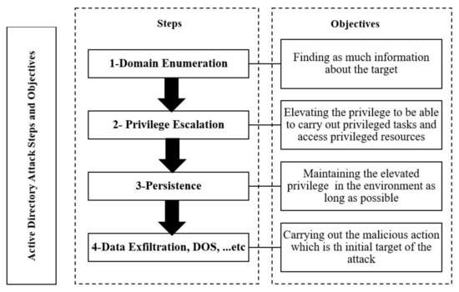
MODULE 04: ENUMERATION
Enumerating Active Directory Users/Groups

Slide 13
MODULE 04: ENUMERATION
Example:
Think of AD as a giant phone book. When you enumerate it, you’re flipping through pages, looking for that one contact you want to mess with.
Practical Tool:
Tools: `enum4linux`, `rpcclient`
To get AD info, enum4linux can dump all kinds of useful info from a Windows server
Command :
enum4linux -U <target-ip>

Slide 14
MODULE 04: ENUMERATION
DNS Zone Transfer
A DNS Zone Transfer allows you to pull down all the DNS records of a domain. It’s typically meant for DNS servers to replicate data, but when misconfigured, it can be used to steal a domain’s entire DNS record.
How We Hack It:
If a DNS server allows unauthenticated zone transfers, we can grab every single DNS record, including subdomains, mail servers, etc.

Slide 15
MODULE 04: ENUMERATION
Example:
It's like a hacker sneaking into the IT department and copying the whole address book of the company’s entire network!
Practical Tool:
Tools: `dig`
Command :
dig @<dns-server> <domain> axfr

Slide 16
MODULE 04: ENUMERATION
LDAP Enumeration
Lightweight Directory Access Protocol (LDAP) is used to access and maintain directory services, like managing user and group information on a network.
How We Hack It:
LDAP can reveal sensitive information about users, groups, and permissions if not properly secured.

Slide 17
MODULE 04: ENUMERATION
Example:
LDAP enumeration is like going to a library and pulling out the index card catalog, only it’s all user and group data.
Practical Tool:
Tools: `ldapsearch`
Command :
ldapsearch -x -h <target-ip> -b

Slide 18
MODULE 04: ENUMERATION
NFS & RPC Enumeration
What is NFS?
Network File System (NFS) allows for the sharing of files between Linux/UNIX systems.
What is RPC?
Remote Procedure Call (RPC) allows programs to execute commands on remote systems, often used in NFS setups.

Slide 19
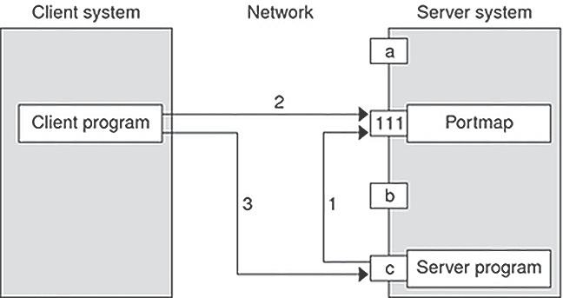
MODULE 04: ENUMERATION
How We Hack It:
By enumerating NFS and RPC, we can check for vulnerable file shares or services that could lead to an exploit.

Slide 20
MODULE 04: ENUMERATION
Example:
NFS is like finding a library with open books (shared files), and RPC is like getting an all-access pass to walk around and do whatever you want.
Practical Tool:
Tools: rpcclien , showmount
Command :
showmount -e <target-ip>

Slide 21
MODULE 04: ENUMERATION
Border Gateway Protocol (BGP)
What is BGP?
BGP is the protocol that makes decisions on how data is routed across the internet. It’s like the traffic controller of the internet highways.
How We Hack It:
By manipulating BGP, attackers can hijack internet traffic, redirecting it to malicious servers or causing Denial of Service (DoS).

Slide 22
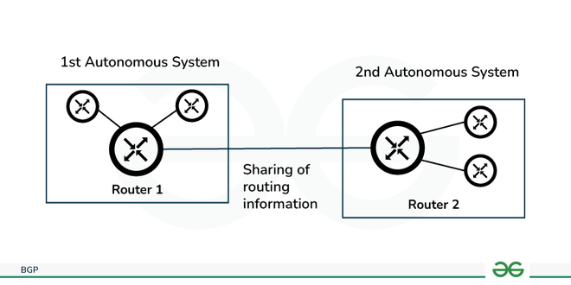
MODULE 04: ENUMERATION
Example:
Imagine redirecting traffic on the internet highways and sending everyone to the wrong exit.

Slide 23
MODULE 04: ENUMERATION
OS Fingerprinting Techniques
What is OS Fingerprinting?
OS Fingerprinting is the technique used to determine the operating system of a target system based on its responses to different network requests.
How We Hack It:
Once we know the OS, we can tailor our attacks to exploit OS-specific vulnerabilities.

Slide 24
MODULE 04: ENUMERATION
Example:
OS Fingerprinting is like a detective using clues (responses) to figure out what kind of car (OS) someone is driving.
Practical Tool:
Tools: `Nmap`, `xprobe2`
Command :
nmap -O <target-ip>

Slide 25
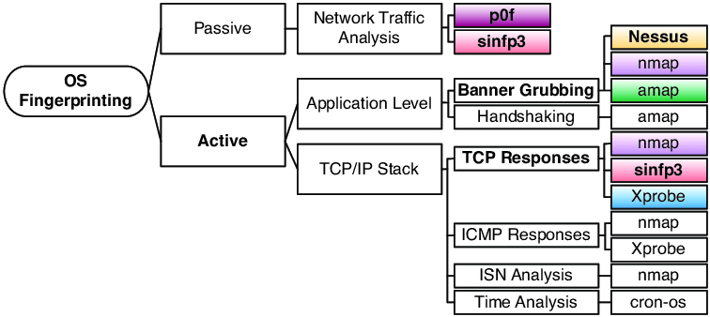
MODULE 04: ENUMERATION

Slide 26
MODULE 04: ENUMERATION
TryHackMe Homework Rooms
"Active Directory Enumeration"
"NFS Enumeration"
"DNS Zone Transfer"
"SMB Enumeration"
"OS Fingerprinting"

Slide 27

MODULE 04: ENUMERATION
THANK YOU

